Slide 1

Modern Programming Tools And Techniques-I
Methods and Constructors

Slide 2
Methods

Slide 3
Method
A method is a construct for grouping statements together to perform a function.
A method that returns a value is called a value retuning method, and the method that does not return a value is called void method.
In some other languages, methods are referred to as procedures or functions.
A method which does not return any value is called a procedure.
A method which returns some value is called a function.

Slide 4
Defining a Method
Syntax:
modifier returnType methodName (list of parameters)
{
// Body of the method(set of statements);
}
Example:
public static void main (String args[])
{
…
}
Method Header
Method Body

Slide 5
Method header specifies the modifier, return type, method name and parameters of method.
public void display()
{…}
The variables defined in method header are called formal parameters or parameters.
int display(int x, int y)
{…}
When a method is invoked, a value as a parameter is passed which is known as actual parameters or arguments.
a.display (3, 5);

Slide 6
Method body contains a set of statements that define the function to be performed by the method.
A return statement using the keyword return is required for a value-returning method to return a result.

Slide 7
Calling a Method
To use a method, we need to call or invoke it.
There are two ways to call a method:
  If the method returns a value, a call to method is usually treated as a value.
  int area = rectangleArea (4,6);
  System.out.println( rectangleArea (4,6) );
  If the method returns void, a call to method must be a statement.
  For example, println method returns void
  System.out.println(“Hello…”);

Slide 8
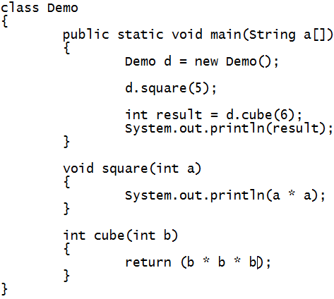
Example 1

Slide 9
Exercise
Create a class named Sandwich. Private data fields include a String for the main ingredient (such as “tuna”), a String for bread type (such as “wheat”), and a double for price (such as 4.99).
Include methods to get and set values for each of these fields. Save the class as Sandwich.java.
Create an application named TestSandwich that instantiates one Sandwich object and demonstrates the use of the set and get methods. Save this application as TestSandwich.java.

Slide 10
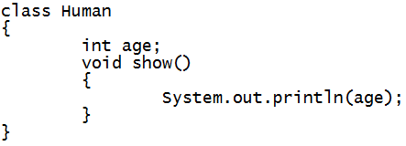
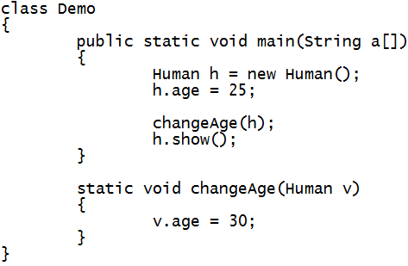
Example 2

Slide 11
CONSTRUCTORS

Slide 12
Constructors
A constructor is a special method that is used to initialize a newly created object.
It is called just after the memory is allocated for the object.
It can be used to initialize the objects, to required, or default values at the time of object creation.
Constructor cannot return values.
Constructor has the same name as the class name.
It is not mandatory for the coder to write constructor for the class.

Slide 13
Default Constructor
If no user defined constructor is provided for a class, compiler initializes member variables to its default values.
  numeric data types are set to 0
  char data types are set to null character(‘’)
  reference variables are set to null
In order to create a Constructor observe the following rules:
  It has the same name as the class
  It should not return a value, not even void

Slide 14
Defining a Constructor
Like any other method
Invoking:
  There is NO explicit invocation statement needed: When the object creation statement is executed, the constructor method will be executed automatically.
public class ClassName {
// Data Fields…
// Constructor
public ClassName()
{
// Method Body Statements initialising Data Fields
}
//Methods to manipulate data fields
}

Slide 15
Constructors Vs Methods
Constructor name is class name. A constructors must have the same name as the class its in.
Default constructor. If you don't define a constructor for a class, a default parameter-less constructor is automatically created by the compiler.
The default constructor initializes all instance variables to default value (zero for numeric types, null for object references, and false for booleans).

Slide 16
Key Points
Default constructor is created only if there are no constructors.
If you define any other constructor for your class, no default constructor is automatically created.
There is no return type given in a constructor signature (header).
There is no return statement in the body of the constructor.

Slide 17
Key Points
The first line of a constructor must either be a call on another constructor in the same class (using this), or a call on the super-class constructor (using super).
If the first line is neither of these, the compiler automatically inserts a call to the parameter-less super class constructor.

Slide 18
Need of Constructors
WAP to find out the volume of a cube in which length, width and height of the cubes are different for two objects.
public class Cube1 {
int length;
int breadth;
int height;
public int getVolume() {
return (length * breadth * height);
}
public static void main(String args[]){
Cube1 obj1= new Cube1();
Cube1 obj2= new Cube1();
int vol;
obj1.length=10;
obj1.breadth=20;
obj1.height=30;
vol=obj1.getVolume();
………

Slide 19
Alternative
public class Cube1 {
int length;
int breadth;
int height;
public int getVolume() {
return (length * breadth * height);
}
void setDim(int l, int b, int h){
length=l;
breadth=b;
height=h;
}
public static void main(String args[]){
Cube1 obj1= new Cube1();
int vol;
obj1.setDim(10,20,30);
vol=obj1.getVolume();
………

Slide 20
Using Constructor
public class Cube1 {
int length;
int breadth;
int height;
public int getVolume()
{ return (length * breadth * height); }
Cube1() {
length = 10;
breadth = 10;
height = 10;
}
public static void main(String[] args) {
Cube1 c1 = new Cube1();
System.out.println("Volume of Cube1 is : " + c1.getVolume());
}
}

Slide 21
Parameterized Constructors
Cube1() { length = 10;
breadth = 10;
height = 10;
}
Cube1(int l, int b, int h) { length = l;
breadth = b;
height = h;
}
public static void main(String[] args) {
Cube1 c1 = new Cube1();
Cube1 c2 = new Cube1(10, 20, 30);
System.out.println("Volume of Cube1 is : " + c1.getVolume()); System.out.println("Volume of Cube1 is : " + c2.getVolume());
}

Slide 22
Exercise 1
Wap to create Student class having fields: name and age and display() method.
Make 2 student objects, initialize 1 object with default constructor and other with parameterized constructor and display the info of both objects.

Slide 23
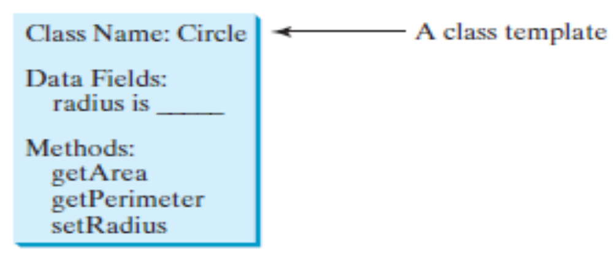
Exercise 2
Wap to create a Circle class (having constructors) to calculate the Area and Perimeter and having the structure:

Slide 24
Let’s Do Some thing
Write a program to create a class named Patient which contains:
Attributes patient _name, age, contact_number
Constructor to initialize all the patient attributes
A method to display all the details of any patient
Create a Patient object and display all the details of that patient.
Future Work:
Assign unique patient_id to each patient automatically.
Store all the patient objects in an array or ArrayList.
Write a method to diplay all the details of a patient with a given patient_id.

Slide 25


